Slide 1
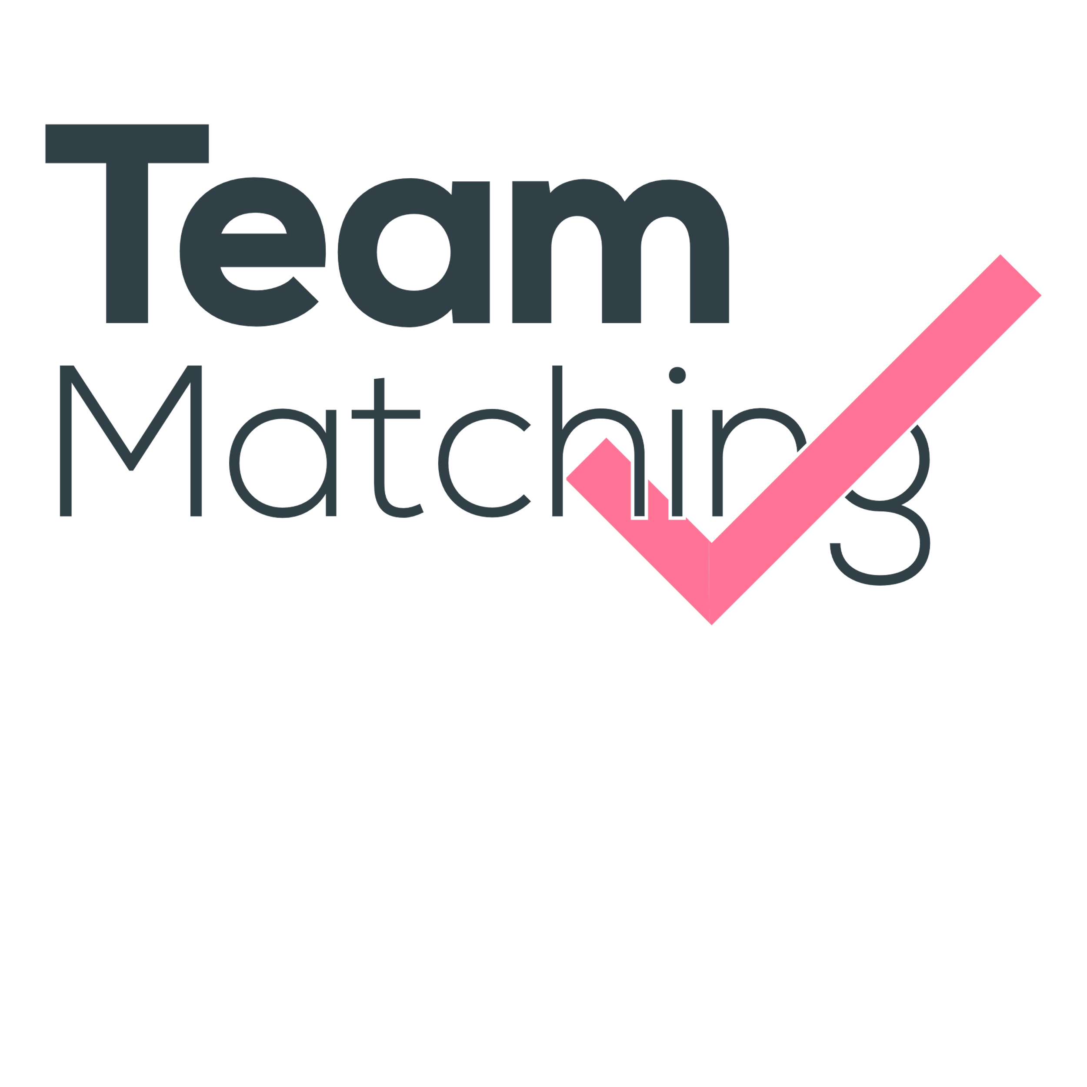
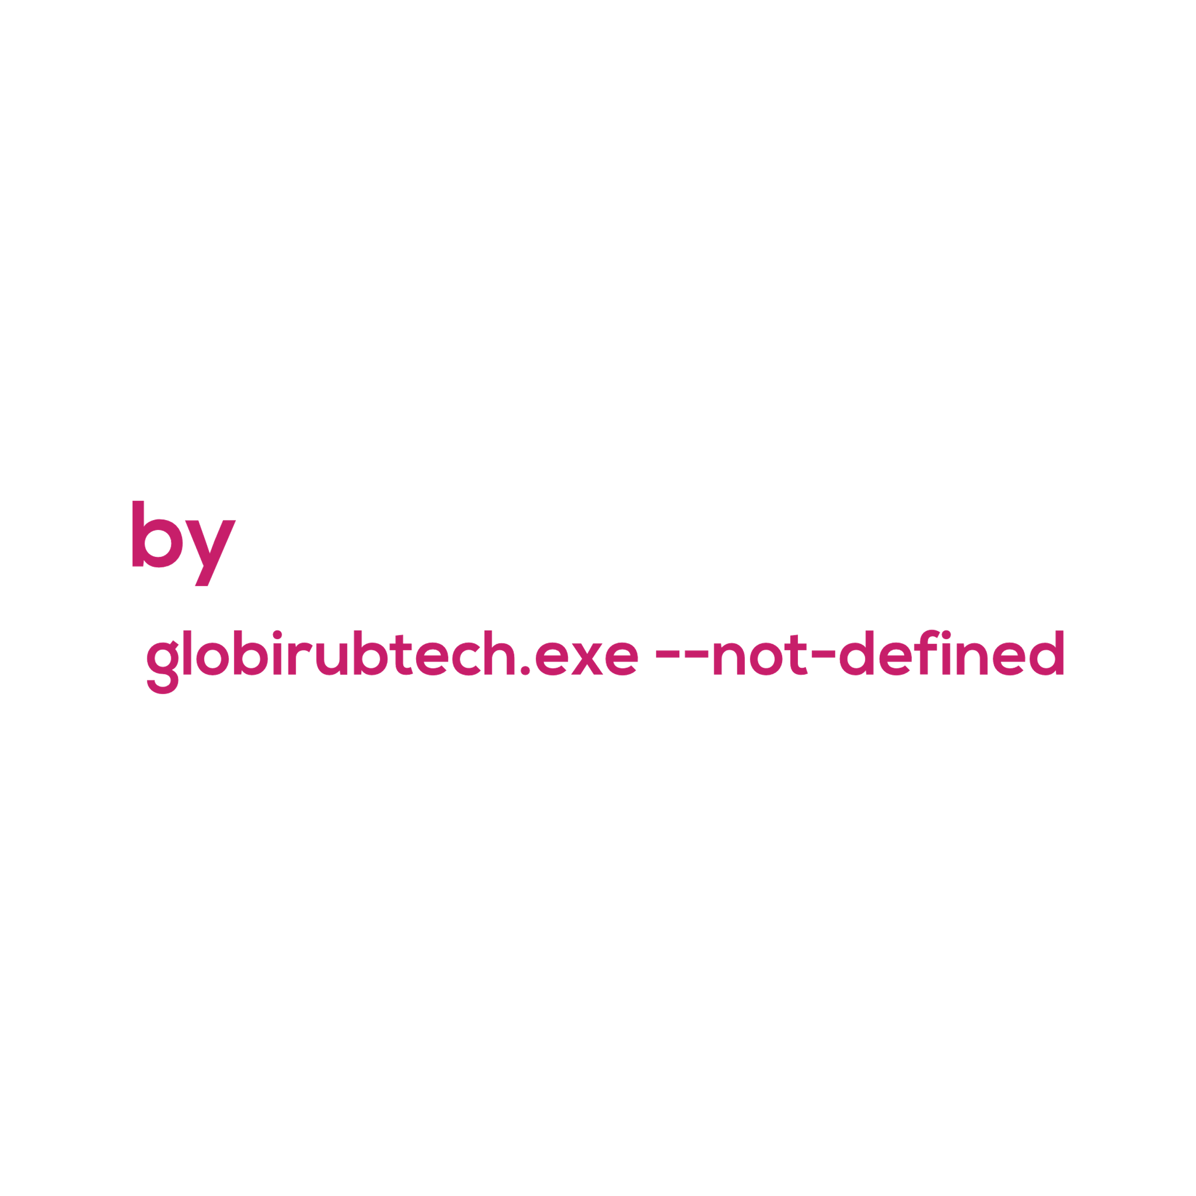
Notes:
Edward Inicia y presenta

Slide 2

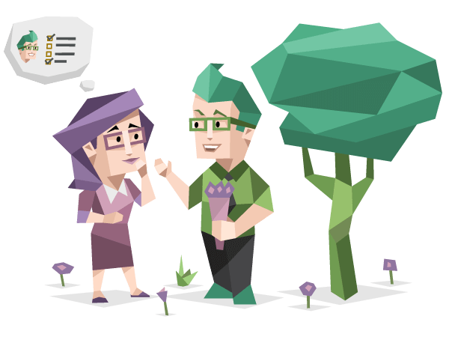
We aim to help to create optimal teams, considering multiple factors like skills, diversity, knowledge and personality.
Notes:
Edward presenta la idea

Slide 3


We love programming contests, but the creation of new teams is a challenge since we are part of a Competitive Programming Club.
Notes:
Edward habla del origen de esta cosa xd

Slide 4


It's not only about the club, it's about all the companies.
Notes:
Edward habla de la escala a la que puede llegar esto

Slide 5


We encourage the teams to have different skills and knowledges, because this allows them to share their abilities while they cover a wide-range of skills.
Notes:
Edward

Slide 6

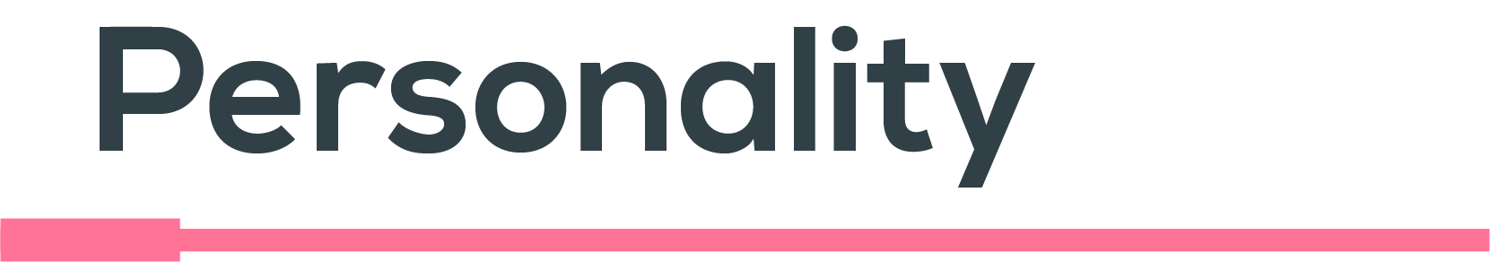
Our personality defines how we interact with our mates, partners and peers. Therefore, it impacts the performance in a team.
Notes:
Edward

Slide 7
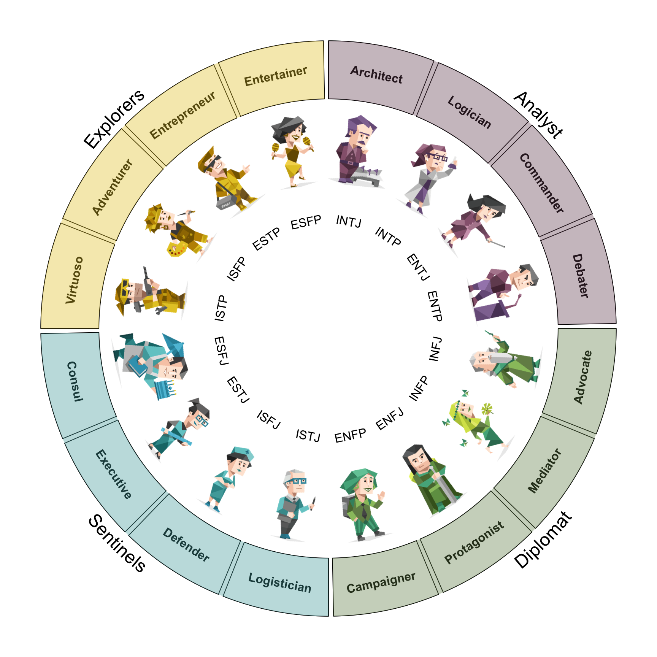

That’s why we decided to implement a Myers-Briggs Type Indicator’s based personality test to match harmonic teams.
Notes:
Edward

Slide 8
What did we implement?
Notes:
Abii

Slide 9




The manager chooses the skills.
The user/ employee answers the test and selects their skills.
The manager can generate teams of "n" persons.
Notes:
Abi hace la explicación general del sistema y como funcionara la demo

Slide 10
Time Complexity
All possible combinations
x
Disjoint sets
N
2
2.5
x
2
N
N
With N=30 the algorithm takes more than 2.5 hours.
With N=10,000 the algorithm
Takes 100 seconds.
Notes:
Sergio explica sobre el algoritmo

Slide 11
Data Manipulation
Find Antichains
Brute Force
Build graph
Dilworth theorem
Bipartite Matching
Vertex Cover
Maximum Antichain
Personality Matching
Notes:
Sergio explica sobre las tecnologías, queda pendiente Neuro Technologies

Slide 12

There's no better way to try on a product than using it.
With a freemium model, we encourage the business to prove our team-matching system.
They’ll be able to test it, engage them with it, and finally pay for it.
Notes:
Abii habla sobre el modelo de negocio

Slide 13

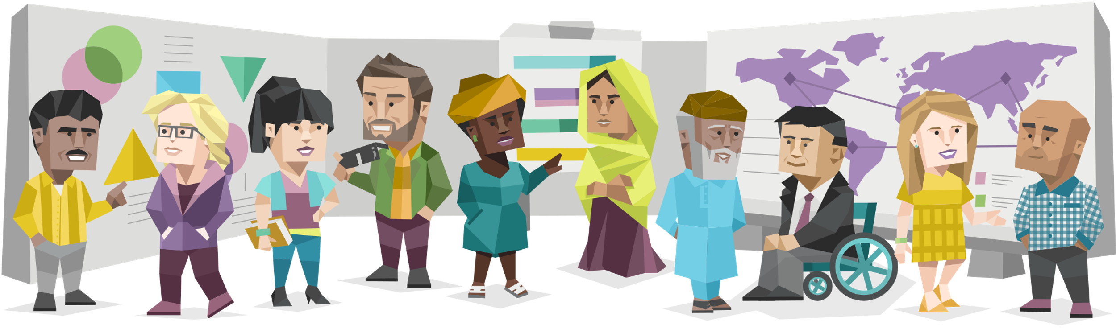
Thanks to our C++ server implementation, the service is highly scalable of worldwide scope.
Which means a huge market for our product.
Notes:
Abii habla sobre escalabilidad

Slide 14


Slide 15


